Slide 1

DREAM
FLOORS
Better homes, Better lives.

Slide 2
TEAM MEMBERS NAME AND ROLL NUMBER
SWAPNIL DUTTA (1705498)
YAJNADEEP MAHAPATRA (1705569)
RAHUL PAUL (1705564)
SOUVIK BANERJEE (1705555)

Slide 3
ABSTRACT
The phenomenon of the falling or rising of the house prices has attracted interest of researchers and many other interested parties.
There have been many previous research works that used various regression techniques to address the question of the changes in house price.
This work considers the issue of changing house price as a regression problem and applies machine learning techniques to predict whether the house price will rise or fall.
This work involves the technique of supervised learning and the values are continuous in regression. We will use Decision Tree Algorithm for regression in order to predict the price.
The performance of the machine learning techniques are measured by the four parameters of accuracy, precision, specificity and sensitivity.

Slide 4
PROBLEMS FACED BY THE CLIENT
Real estate agent versus online advertisements.
Transparency
Basic amenities
Comparison

Slide 5
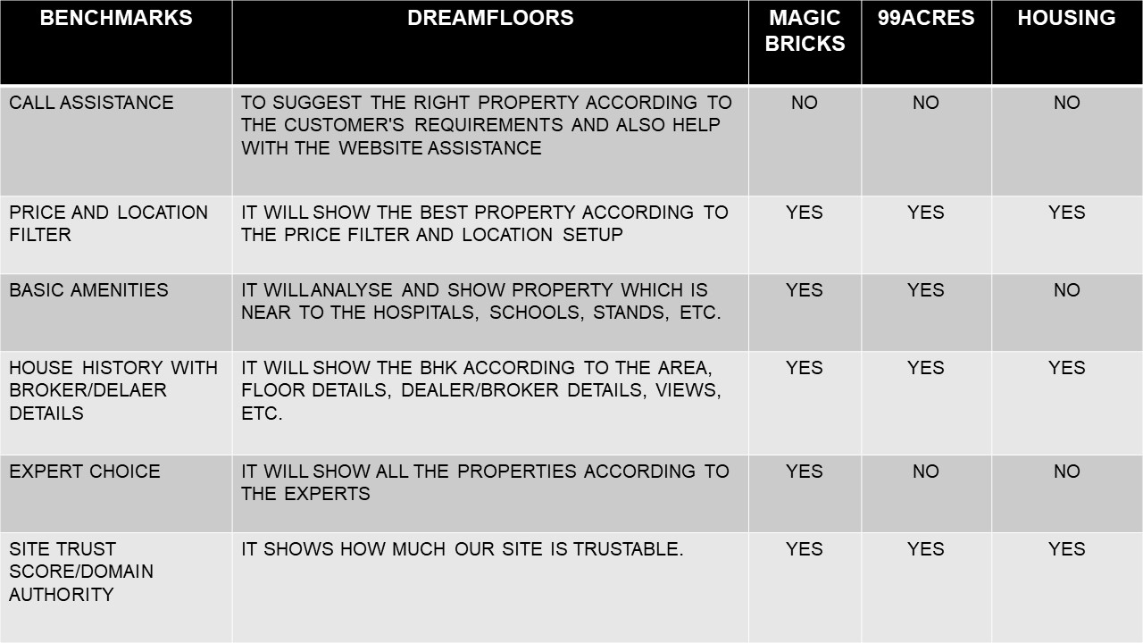

Slide 6
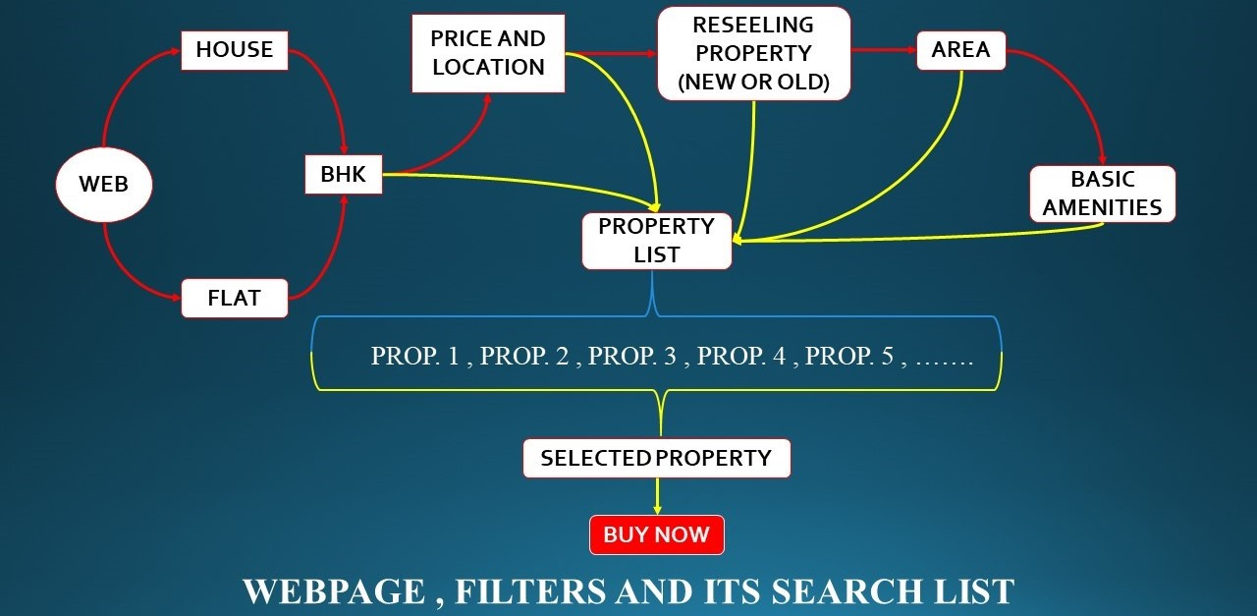

Slide 7
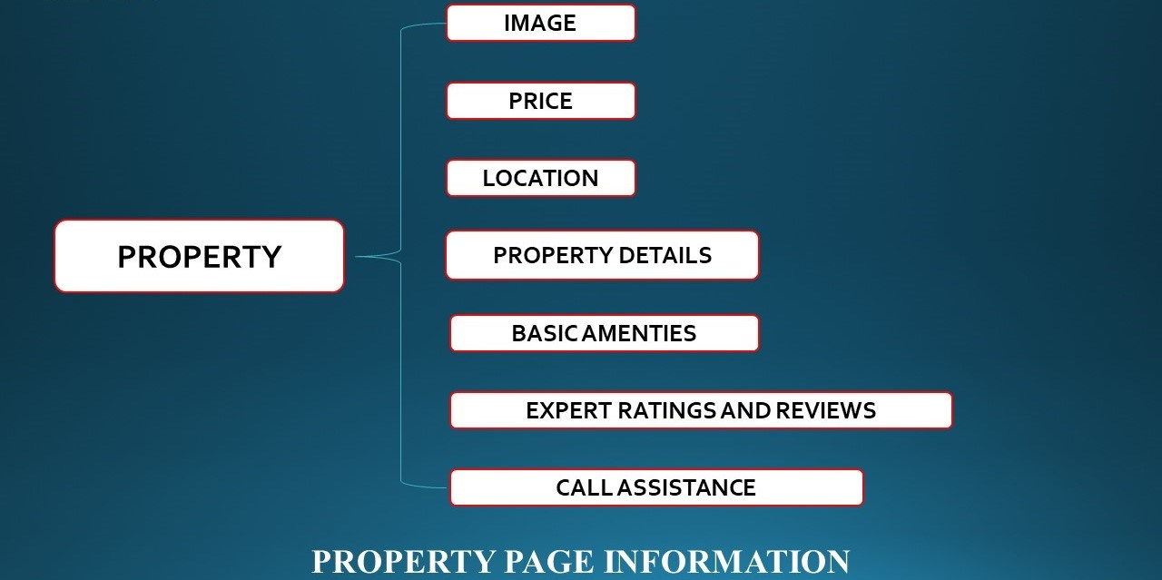

Slide 8
TECHNICALITIES
This work considers the issue of changing house price as a regression problem and applies machine learning techniques to predict whether the house price will rise or fall.
This work involves the technique of supervised learning and the values are continuous in regression. We will use Decision Tree Algorithm for regression in order to predict the price.
The performance of the machine learning techniques are measured by the four parameters of accuracy, precision, specificity and sensitivity.
We have used Scikit Learn, Pandas, Matplotlib libraries for our project.

Slide 9
PRODUCT CONCEPT
Our product is based on making the estate buying more transparent and convenient.
Prevention of fraudulent dealings.
Proper documentation of estates.
Beneficiary to both Dealer and Buyer.

Slide 10
SOLUTION
Complete transparency of the deal, there are no middle men involved, hence, both the buyer and the seller are benefited.
There are no hidden costs involved, hence, both the buyer and the seller get the maximum profit.
The properties are well filtered out with all the basic amenities.
A well comparison between the properties gives the best deal to the buyer.
No illegal transactions and fraudulent dealings are involved.

Slide 11
SCALABILITY IMPROVEMENT
Deployment of website using secured frameworks in order to avoid common vulnerabilities of the website.
Regular security patches.
Reaching more potential audience by the development of an user friendly application in the near future.
We will deploy database and cloud as well as we deploy clustering techniques in order to increase data storage techniques to improve the accuracy of the ML model.

Slide 12
TIME ESTIMATION AND ACCURACY IMPROVEMENT
We will improve our ml model in order to get proper accuracy regarding data from dataset.
We will also work on time estimation so that in a short period of time we will get best product.

Slide 13
SWOT ANALYSIS
STRENGTHS :- Our product will show the best house in the best price.
WEAKNESS :- Security issues.
OPPORTUNITIES :- Both seller and buyer are benefited from our website.
THREATS :- Cyber crime.

Slide 14
PROPOSED COST ESITIMATION
By estimating size of the database, cost of hiring a company for website development and maintenance, we have estimated the product cost to be 1.26 million USD.

Slide 15
MAKETING CONCEPT
Identifying the target market for profitable outcomes.
Budget for market expenses.
Encouragement of referral codes.
Developing brand awareness through regular advertisements on various platforms.

Slide 16
CONCLUSION
Our product is in the developing phase but we guarantee that once the product is completed it is going take over the market in terms of popularity and profitability.
Our product will be the one which will set a benchmark for all other real estate agency.
THANK YOU

